Slide 1
CS-430 Introduction to Algorithms
HOMEWORK – 1
Team Name: NULL
Team members: Aditya Dasgupta (seat 14) and Devyani Gauri (seat 25)

Slide 2
TECHNOLOGIES USED
JAVA: to write the sorting algorithms(insertion sort and merge sort)
JFrame: to make the GUI with the visualizations to indicate the type of sorting algorithm being used to sort a random list of numbers

Slide 3
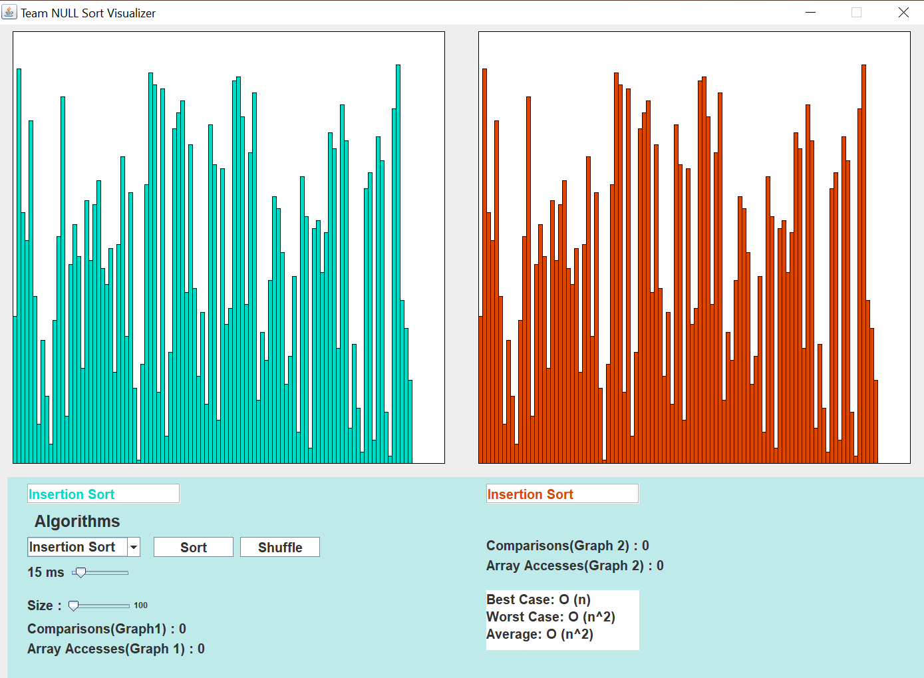
OUR GUI
Can select between Insertion Sort, Merge Sort, and Both(to compare)
Click to sort
Click to get a new random list
Shows comparisons and number of array accesses for Graph 2
Shows comparisons and number of array accesses for Graph 2
Change the speed of visualization
Change the size of list of numbers
Runtime information about selected algorithm

Slide 4
VISUALIZATIONS
We have two graphs in our visualization, that work for three cases:
Insertion sort: The 1st graph shows the sorting of the list, and then the 2nd graph shows the same sorting of the same list. (Both of them show the number of array accesses and comparisons performed)
Merge sort: Works the same way, except the visualization shows how merge sort works on a random list
Both: The 1st graph performs insertion sort, then the 2nd graph performs the merge sort

Slide 5
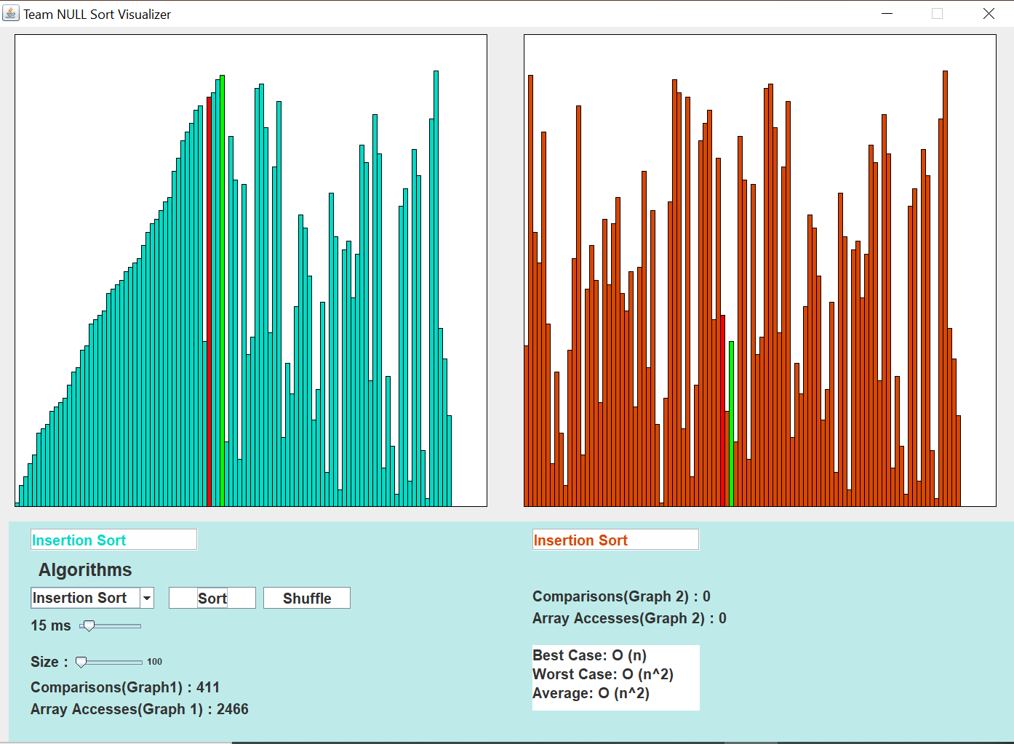
INSERTION SORT
Mark the element being compared to
Mark the current element
Shows that both graphs will show insertion sort
Information about Insertion Sort

Slide 6
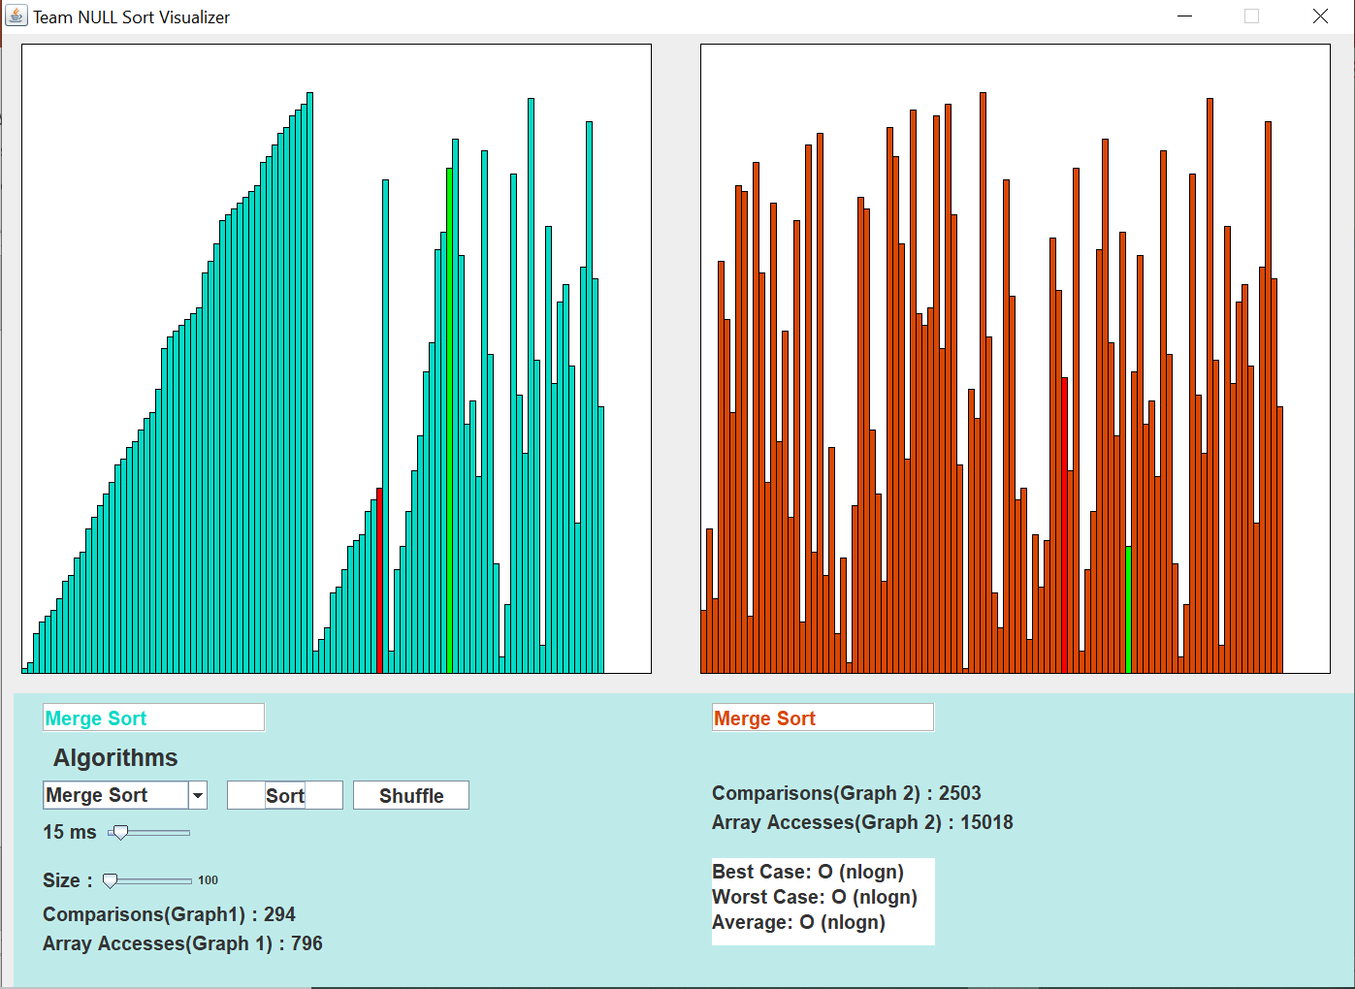
MERGE SORT
Shows that both graphs show merge sort
Information about merge sort

Slide 7
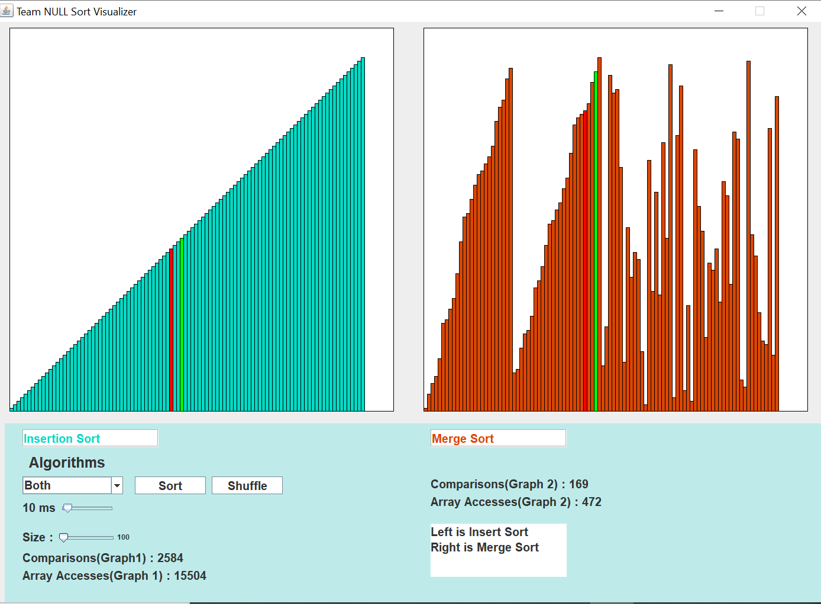
COMPARING INSERTION AND MERGE SORT

